Slide 1
Special Events Development & Management Final Assignment
By: Emily Yalowsky

Slide 2
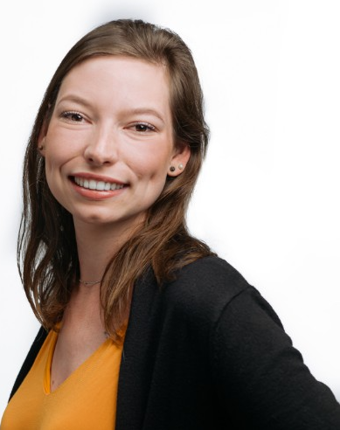
Introduction of Event Professional
Grace Howes
Graduate of the Niagara College Graduate PR Certificate Program
Community and Public Relations Coordinator at YWCA Niagara
Has been with the YWCA for 1 year
Leads the committee which plans the Niagara Leadership Summit for Women

Slide 3
The Niagara Leadership Summit for Women
An annual summit, one day event on a Saturday in October
Held at Brock University
Goal: to gather women across Niagara and empower them to take on leadership roles, gain a better understanding of what leadership means
When a woman is in a leadership role, they make choices that benefit other women.
Events included: Workshops, seminars, panels, lunch, networking opportunity for women, one-to-one chats
Avg. attendance of 250-300 women, 30+ guest speakers

Slide 4
The Virtual Niagara Leadership Summit for Women: Original Event Walkthrough
Theme: Empowerment of Women EVERYWHERE!
Goals:
To reach women in Niagara region (and further) to empower women in leadership roles
To empower women to find the leader within themselves
Take-away message from event: A leader is not just being a CEO. A mom is a leader of her family, a student is a leader of their group... anyone can be a leader.

Slide 5
Event Platforms
This virtual event will utilize two platforms: TELUS Business Connect Meetings, ZOOM and a conference website by EventMobi.
TELUS: Allows for safe and private virtual experience, allows for large scale virtual meetings
ZOOM: Allows for multiple streaming opportunities, opportunity for large scale meetings
EventMobi: An online planning and conference hosting website, integration with ZOOM, made for conference hosting, allows you to track event results

Slide 6
Event Format
Saturday Oct. 16 and Sunday Oct. 17, 2021
8:30 am to 5 pm both days
Will be online interaction between audience/attendees and guest speakers
Will consist of leadership and empowerment workshops
ALL workshops and speakers will be recorded for playback for attendees who did not attend that workshop or missed a day of the conference
Networking opportunities available through virtual lunch and designated networking event

Slide 7
Event Engagement
Due to the nature of the event being online, there will be more interactive engagement needed.
Contest: on Day 2 of the event there will be a scavenger hunt that will engage attendees by having to google and go to different guest speakers to answer questions
Networking event: Attendees can register for 5 - 10 minute time blocks with a speaker of their choice to network, ask questions, or enter an open room to connect with other women.

Slide 8
Event Engagement Continued
Virtual lunch: while no lunch is provided because of the virtual nature of the event, it is encouraged that attendees register and enter a “lunchroom” to engage in conversation and networking opportunities with likeminded women. Grab some fresh coffee, your favourite snack or lunch and connect with new friends.

Slide 9
Order of Events
Day 1
8:30 am – 10:30 am
Guest speakers in different time blocks
Between 1-2 hours per speaker
10:30 am – 12 pm
Welcome, keynote speaker speakers introduced by event leader Grace
12 pm – 1 pm
Lunch
1 pm – 4:30 pm
Workshops on networking, being a leader in the community
Guest speakers
4:30 – 5 pm
Daily round up of important theme learned from day 1 portion of the conference
Day 2
8:30 am – 10:30 am (same as Day 1)
10:30 am – 12 pm
Contest –– scavenger hunt
12 pm –– 1 pm
Virtual lunch, grab coffee and join a breakout room and dine with inspirational women
1 pm –– 3 pm
Networking event
3 pm –– 5 pm
Day 2 wrap up
Conference (inspirational video of women taking charge in their community)
Final remarks

Slide 10
Measuring the Event’s Success
To evaluate the success of the 2021 Virtual Niagara Leadership Summit for Women, 3 areas will be evaluated:
Look at how many tickets were sold (how many attendees registered for event)
Goal: 250 – 350 tickets is the goal with this being the first year online, as this is the average goal.
Evaluating attendee feedback
Send out survey to attendees to understand what they liked, what they didn’t like, what they would like to see for future virtual events
Internal goals: how much money was raised, creating a “stretch” goal. See if there was any growth in event interest by exceeding the tickets sold/ attendance goal

Slide 11
What I Learned About Event Planning
You ALWAYS need a critical path!
Events may not always go your way, expect the unexpected
Be as organized as you can
BUDGET!!! Know where the budget is needed most
Keep in mind: what is the incentive to your audience? Why should people come to your event

Slide 12
What I Learned About Planning Online Events
As a result of losing the in-person connection, you need to make the online event as interactive and engaging as possible
Most of your budget will be spent on online technology to bring your event to life
Utilize your sponsors to your advantage
You have the potential to reach more people in an online platform

Slide 13
Thank you, Emily for an incredibly engaging and eye-opening learning experience!

